Slide 1
KEY VERTICALS www.KeyVerticals.com
Publisher Platform Demo
30 MINS/Session

Slide 2
What is Key Verticals
Key Verticals is a Premium Lead Generation Platform For Established Companies in Established Verticals.
Examples.
Established Vertical – Insurance
Established Company – Mansard Insurance

Slide 3
What is Affiliate marketing?
When you’re promoting offers this is really simple. In generic terms, you match traffic sources to offers, arbitrage ads, landing pages and offers through the traffic source and generate more revenue than you are paying for the traffic.
So many people over-complicate this, but it really is that simple.

Slide 4
Three Categories of Publishers/Affiliates We work with (For Insurance):
The individual affiliates: This comprises of individual publishers with laser targeted high traffic websites/blogs/forums as well as offline affiliates with lead sources that can be integrated seamlessly into our system.
The internet marketer, auto quotes comparison site owner, offline marketer and so on easily fall into this category.

Slide 5
Businesses, Organizations and Membership Clubs: Becoming an affiliate is a great way for individuals and businesses to offer an additional benefit to their employees, customers, or members.
A Premium Discount and Residual Payments will be applied for organizations who qualify, and it's easy! Just complete the Affiliate Sign Up Form below, and a KeyVerticals representative will contact you to continue the process.

Slide 6
Vehicle Registration Portals, Outlets and Agents. For this category, we work out a special arrangement with underwriters so that cover letters can be issued through these outlets and Agents to customers who want to buy and pay instantly for immediate cover.
Insurance certificates can then be issued later by the underwriters (insurance companies).

Slide 7
How Does It Work?
You Implement an Advertiser Lead Form and Get Paid a Percentage of the Winning Advertiser Bid for every Successful Lead Generated!

Slide 8
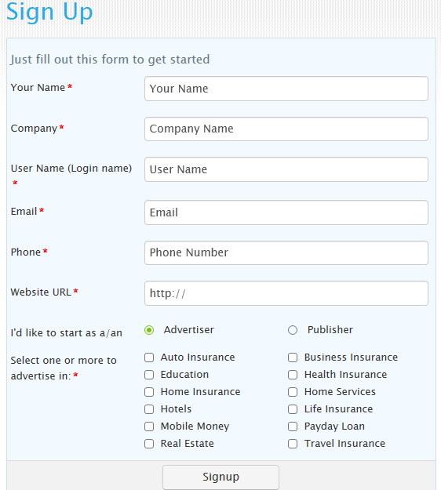
STEPS...
Sign Up
http://www.keyverticals.com/sign_up

Slide 9
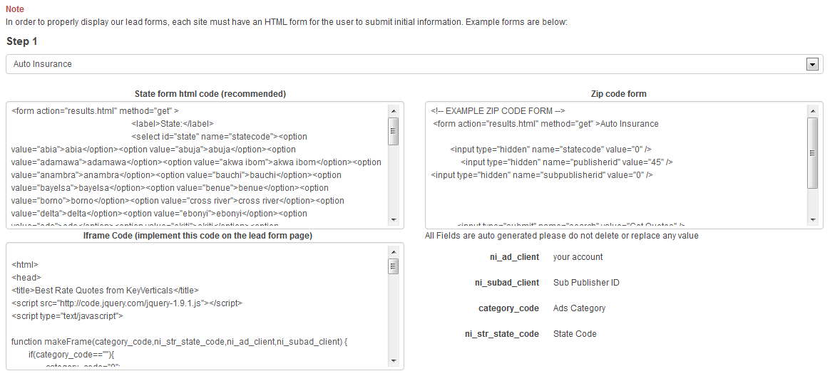
Get Code & Install on Your Site
Detailed Instructions in Member Area...& Live Help From Account Manager & Tech Team

Slide 10
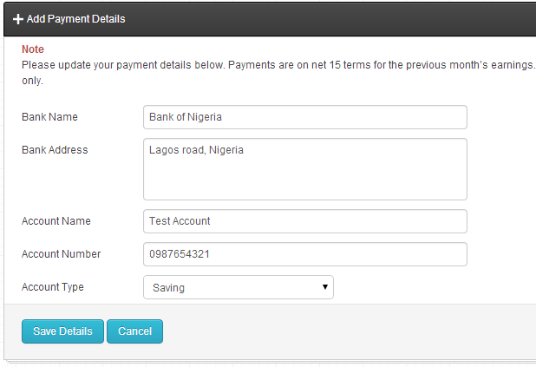
Add Payment Details
Drive Traffic.

Slide 11
Features
Connection to Big Name Advertisers: With Big Budgets and Big Goals. Implication: Higher Revenue For You.
Superb Technology & Tools: You Have complete power to use the Platform Features in a Custom Way... From Implementing the Form Codes to Any Areas of Your Website, to Getting Information on Your Conversion Rates and Basic Conversion & Ad Metrics.
Relevance: We Have Advertisers in most Established Niche and we give you the freedom to choose which Niche/ Vertical is more Relevant to your Web Site/Property.
. And Many More..

Slide 12
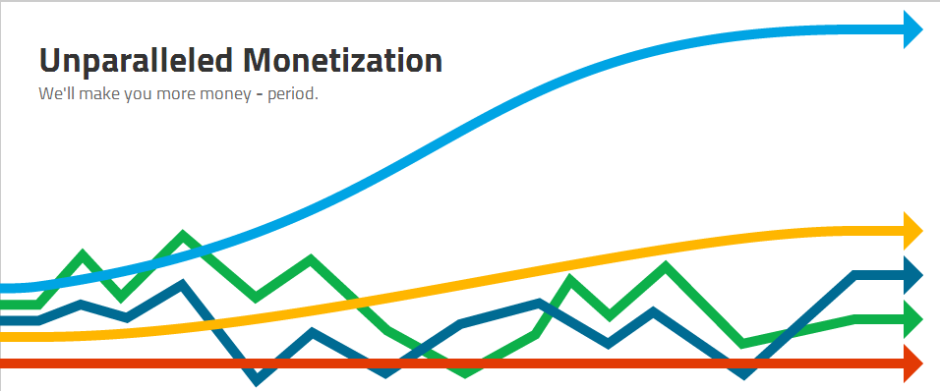
Why Should I Sign Up NOW?
Superior Monetization

Slide 13
Flexible Payouts:
We Wire Your Money Directly to your Bank Account. No Headaches, No Wahala.
We Also discuss payment terms/cycles with you and can adjust to suit your specific needs*... We are a Partner not a Dictator.
Consistent Payouts;
We Pay You every time on net 15 basis. Our Model earns you ready to remit Revenue in Real Time therefore we always have the funds ready to pay you for your Media Buys, Traffic & Conversions.
*Qualification Required

Slide 14
Opportunity to Work With Us;
Get Technical Help; We will work with you to integrate our site codes effectively on your website or App/Platform.
Advice on Funnel Integration & Optimization for Max Revenue Earnings; Integrating our Lead Form for max conversions and Revenue takes skill and Finesse.
We Will Work with you to Implement Lead Form in Areas of your Web Property that Guarantees Maximum Revenues to you.
Guaranteed Acceptance; We will immediately approve you if you have what it takes. If you don’t have what we need, we will work with you till you get it. Your Interest becomes our Interest.

Slide 15
Who’s An Ideal Partner?
All Partners on the KeyVerticals.com Network are also called Suppliers. To be a Supplier, you should fall into either of these categories:
Established Web Property Owner: This is for someone with a Web Property, e.g., a Website, A web App, a Mobile App etc... That has high Organic Traffic either through Installs, or Search Engine or any other means we deem to be Organic.
Media Buyer: This is for someone who buys Advertising from some of the Leading Digital, Display, Mobile, Search & Social Advertising Channels Online. Email & Bulk SMS could be approved if we deem the Process to be Spam Free and White Hat. For this Person, A Landing Page is all that is required to be Approved.
Strategic Partners: These are Individual or Corporate Suppliers who already deal with our Target Audience and see a way to make even more by strategically integrating our Funnel Into Their Sales Funnel. Examples include an Auto Seller Who decides to implement the Auto Insurance Lead Form to every successful car order thereby making even more money from this.
And So Much More: The Potential is only limited by your Imagination.

Slide 16
What to Do Next?
Go to the KeyVerticals sign up page at http://www.keyverticals.com/sign_up and sign up as a Publisher.
Fill Out the Form Completely and select the Verticals You would Like to Partake in... (You can always Add A New Vertical Later).
Wait for an Email From Us.
Ready For Your Big Payday? No Other Platform Monetizes Nigerian Traffic Like We do on the Planet. None at all. So if you’re ready to get your own share of the Digital Ad Revenue, say:
LETS GO THERE!!!!!!

